Slide 1

PROG6212 POE CONTRACT CLAIM SYSTEM PRESENTATION
How the system submits, reviews, Tracks, and Automates. By Simphiwe Mathenjwa ST10258505

Slide 2
How Lecturers Submit Claims
• Lecturers log in and complete a claim form.
• Upload supporting documents (PDF, images).
• System validates required fields before submission.
• Claim stored in the database with 'Pending' status.

Slide 3
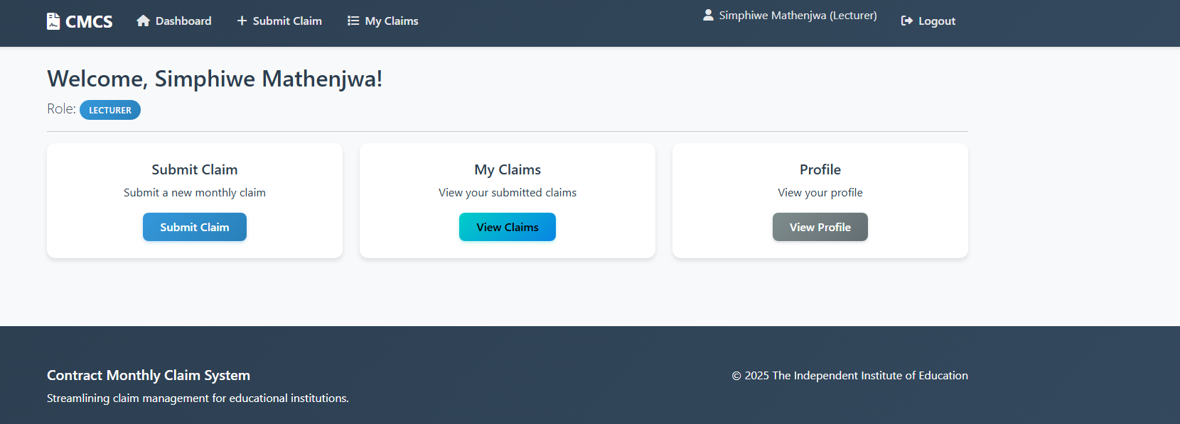
Lecturer dashboard

Slide 4
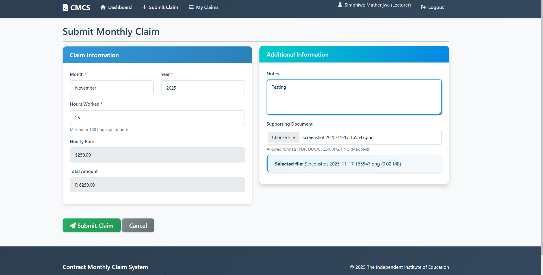
Submit claim view

Slide 5
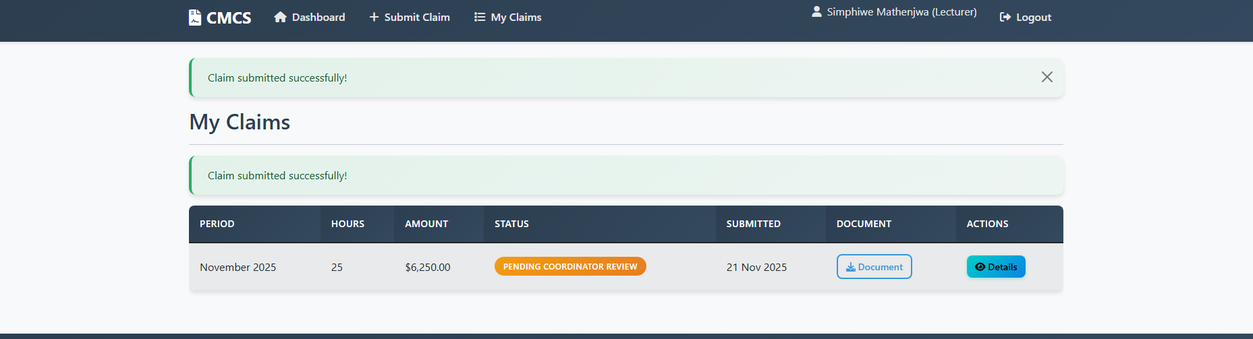
SUBMITTED CLAIM

Slide 6
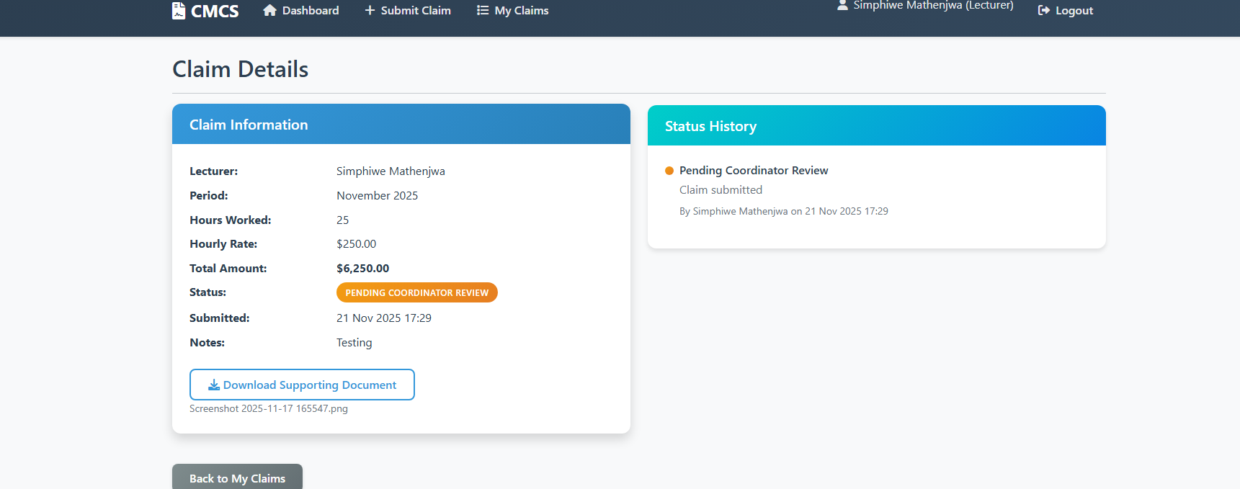
THE VIEW OF THE CLAIMS DETAILS

Slide 7
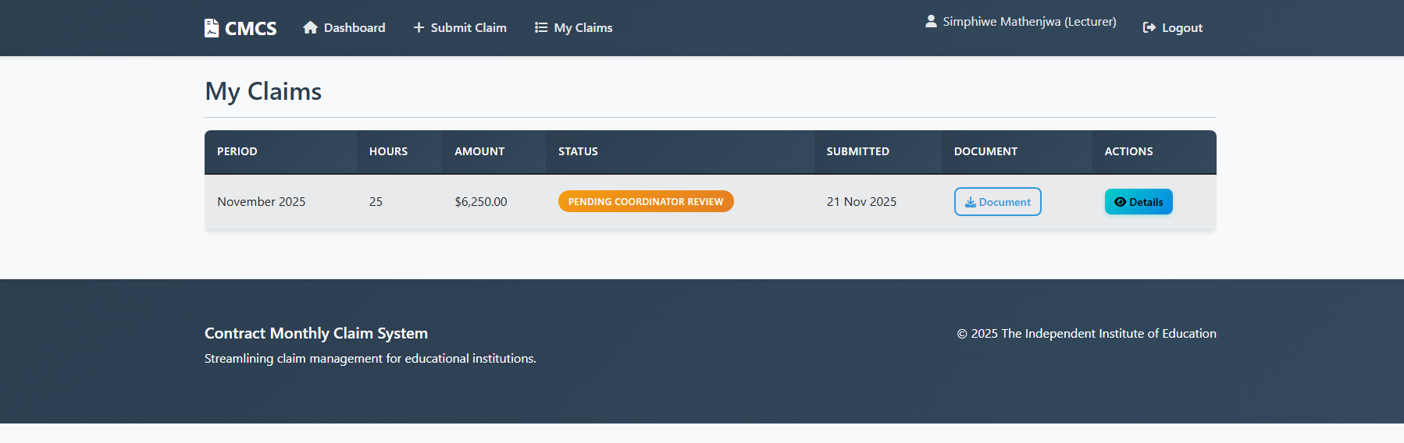
VIEW OF THE “MY CLAIMS’ SECTION

Slide 8
Coordinator and Manager Review
• Coordinators and managers log in to view all pending claims.
• They can approve, reject, or return claims for correction.
• Views include filters for date, lecturer, status, and department.
• Submitted documents can be downloaded and inspected.

Slide 9
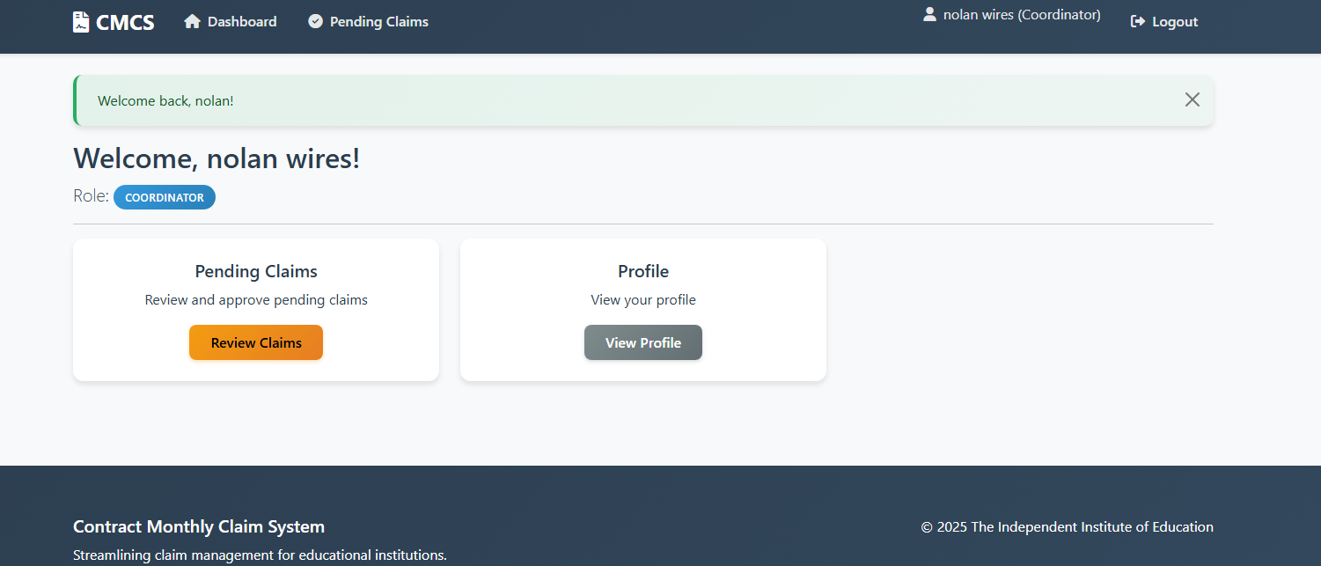
Coordinator dashboard

Slide 10
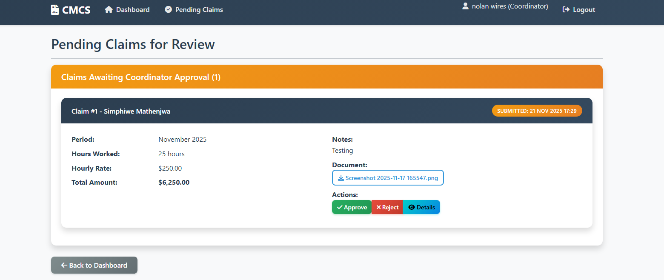
“pending claims view”

Slide 11
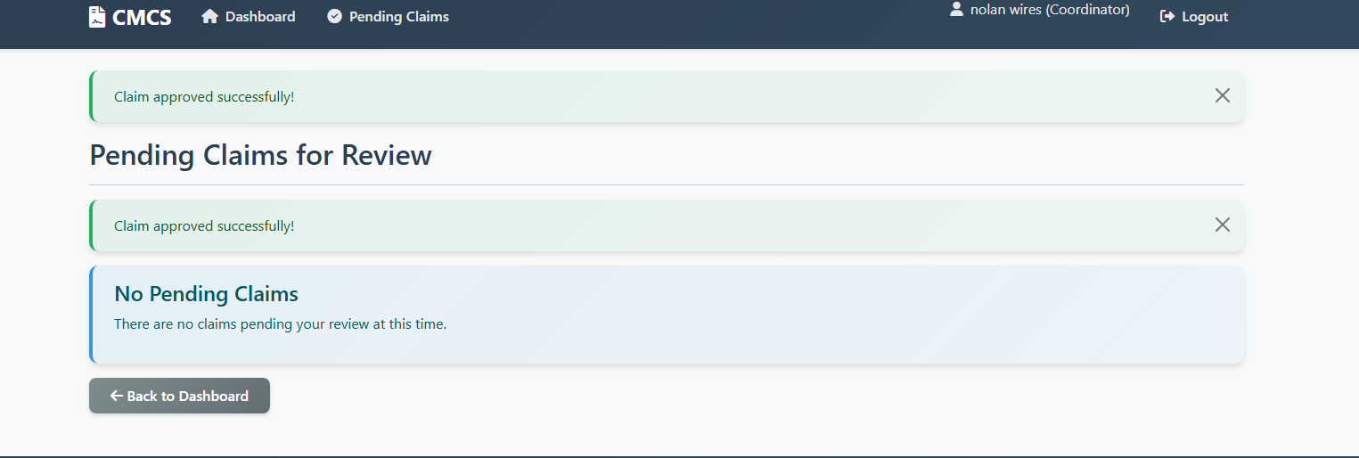
Approved claim

Slide 12
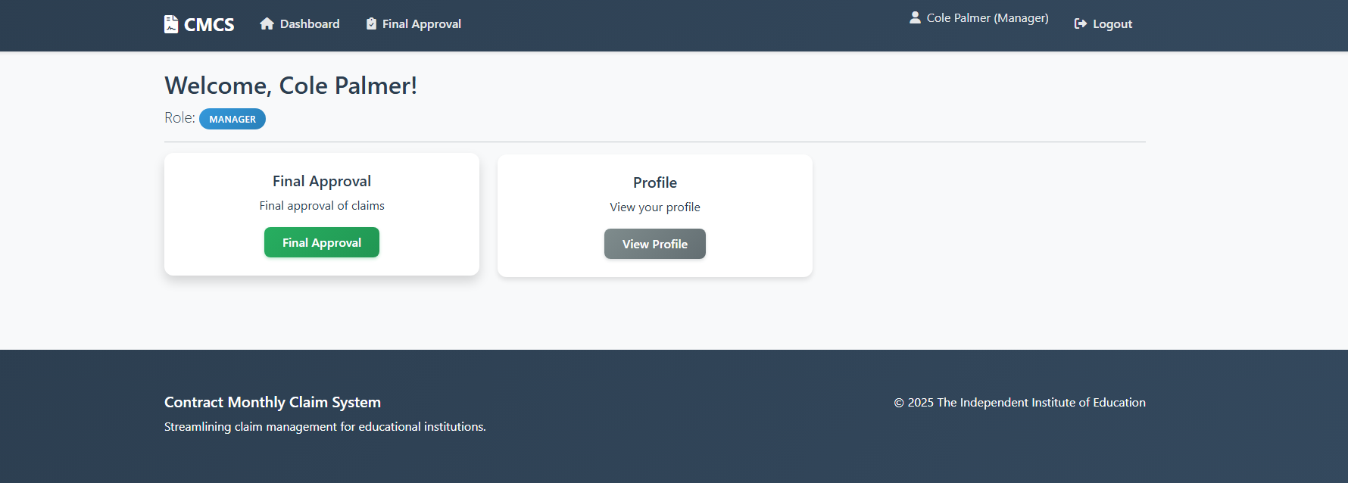
Manager dashboard

Slide 13
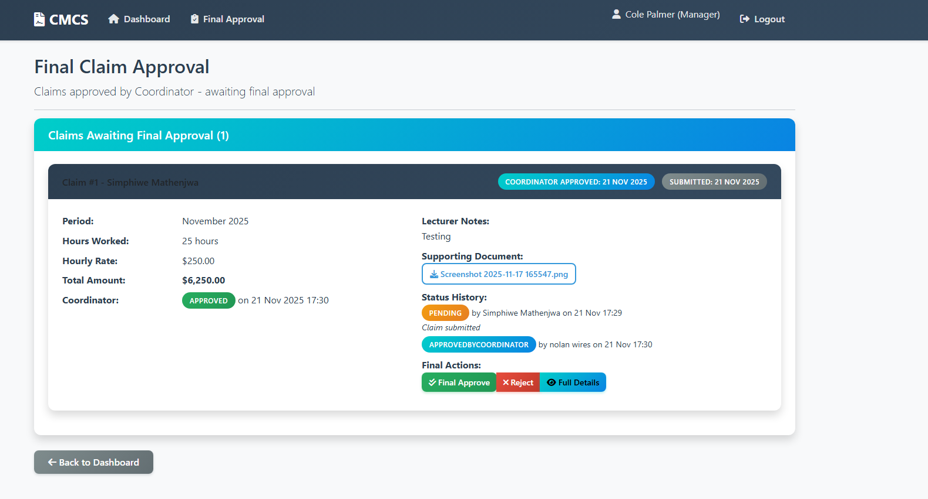
Final claim view

Slide 14
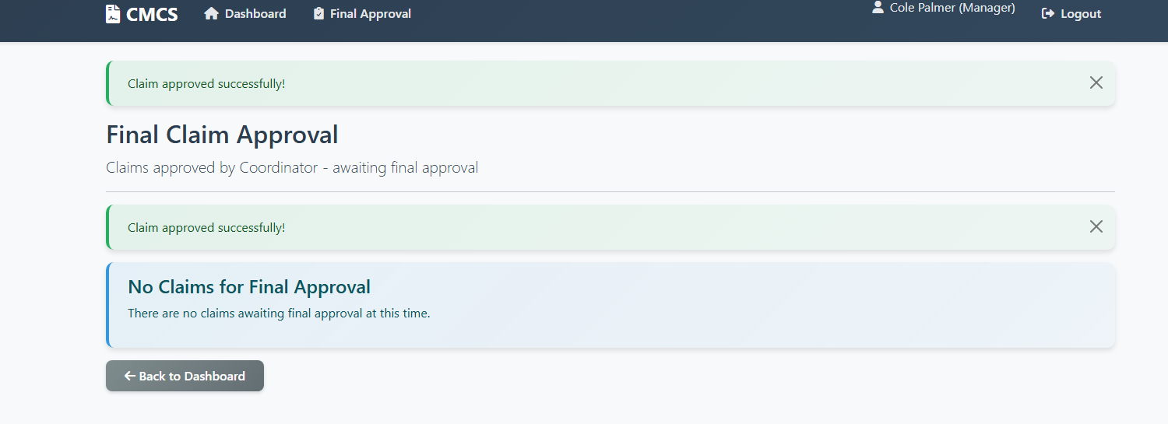
Claim approved

Slide 15
Lecturer Document Upload
• Uploads handled via form file input.
• Files stored in server directory or cloud storage.
• File paths linked to individual claims.
• Ensures traceability and secure access for reviewers.

Slide 16

Claim Status Tracking Implementation
• Each claim has a Status field in the database.
• Status updates when coordinator/manager performs an action.
• Lecturer dashboard displays real-time claim status.
• Statuses include: Pending, Approved, Rejected, Returned.

Slide 17
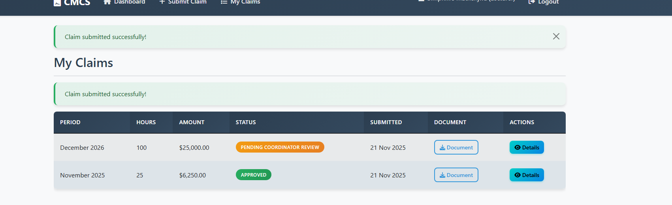
Pending claim

Slide 18
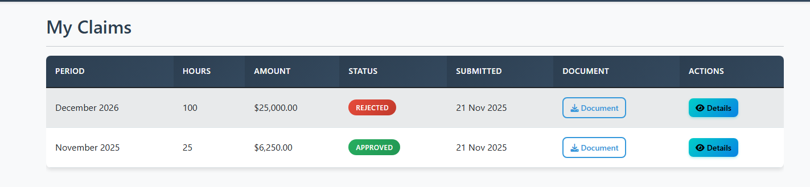
Rejected claim

Slide 19

Application Enhancements & Automation
• Role-based dashboards with tailored functionality.
• Automated email notifications for status changes.
• Coordinators/managers see prioritized claim queues.
• HR view aggregates approved claims for payroll processing.
• Reduced manual tracking and faster processing workflows.

Slide 20
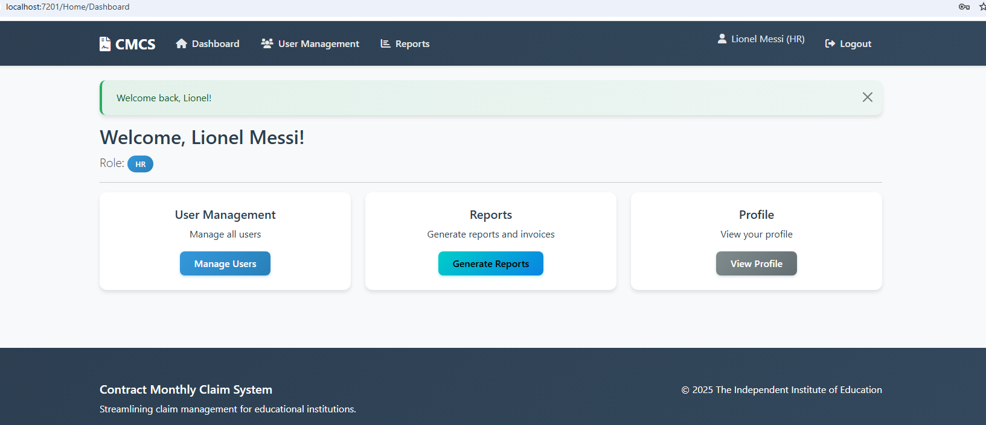
Hr dashboard

Slide 21
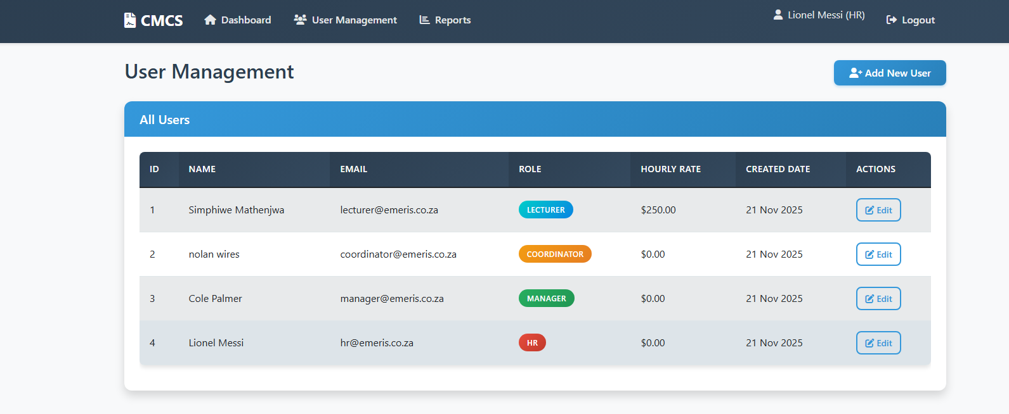
User management

Slide 22
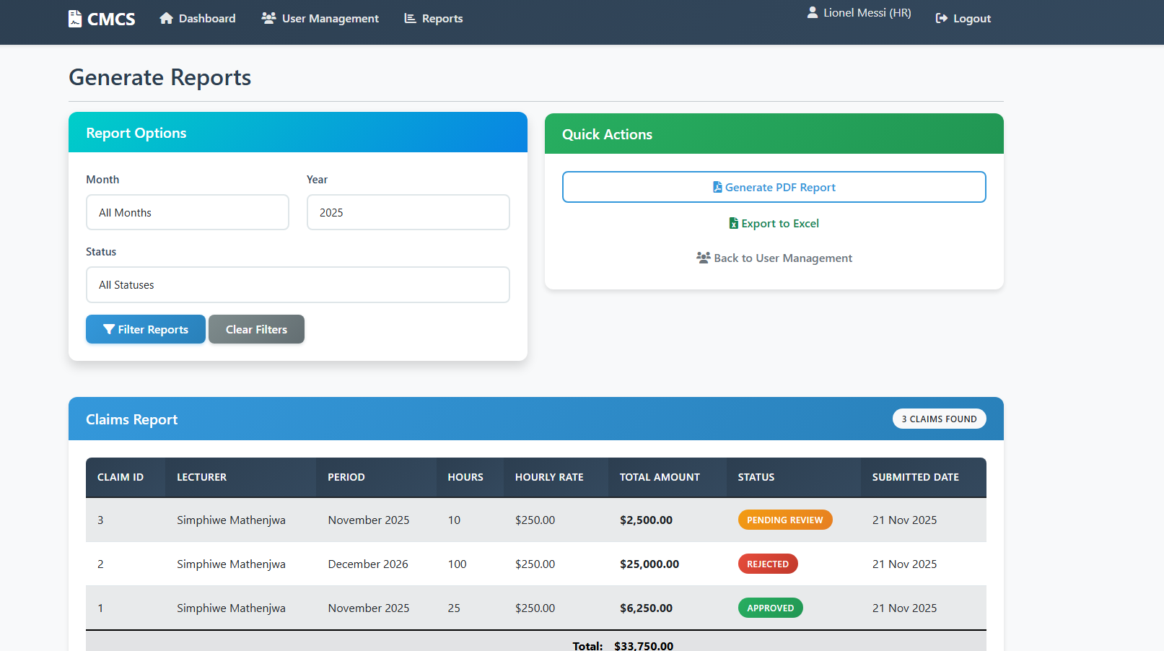
Generate report view

Slide 23

Thank you
Simphiwe Mathenjwa
ST10258505
GitHub link: https://github.com/Mathenjwa-Simphiwe/PROG6212-SUMMATIVE.git

